Slide 1
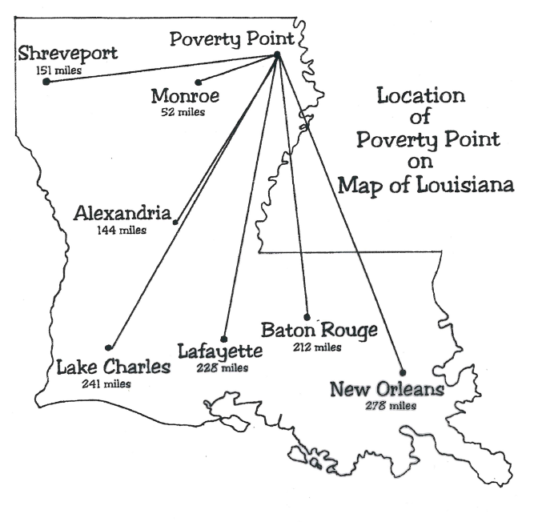
Overhead Transparency 1

Slide 2
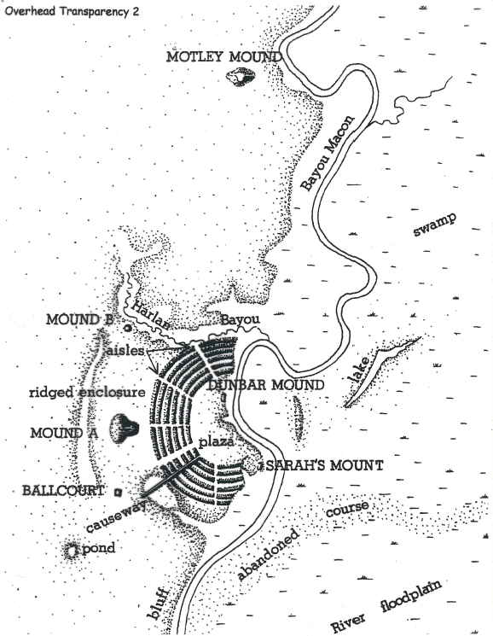

Slide 3
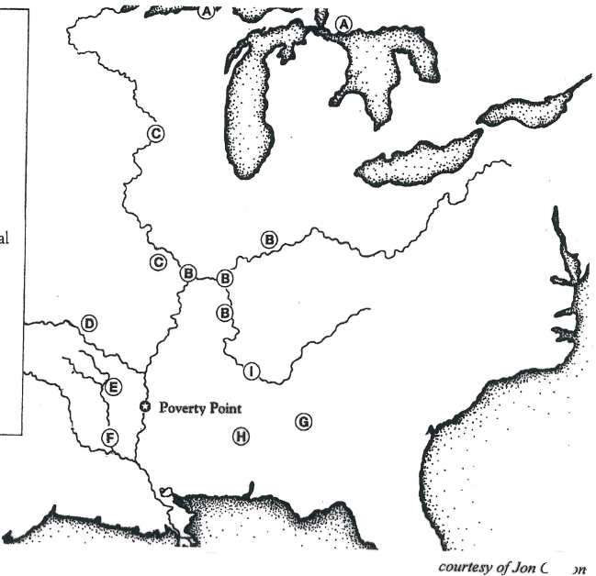
Overhead Transparency 3
Source areas of Poverty Point Trade Materials
A
Copper
D
Novaculite, Hematite, Magnetite, Quartz Crystal
G
Soapstone, Schist
B
Gray Northern
Flint
E
Citronelle Gravel
H
Tallahatta Quartite
C
Galena, Crescent
Hill Chert
F
Catahoula Sandstone
I
Pickwick Chert
Drawing by Denise A. Malter
Courtesy of Jon Gibson

Slide 4
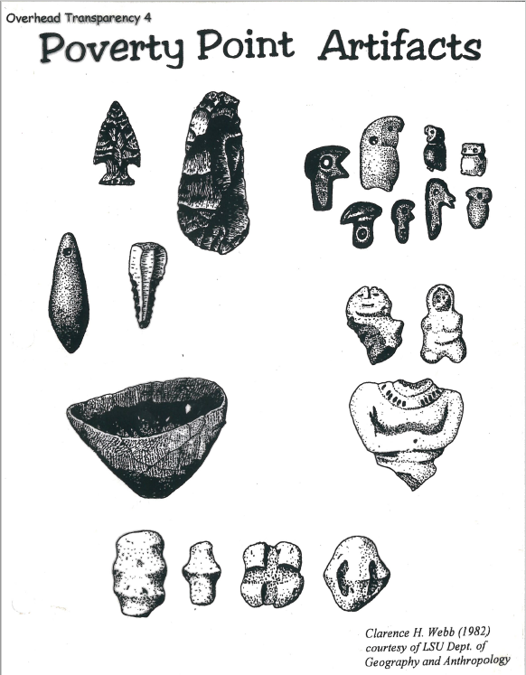
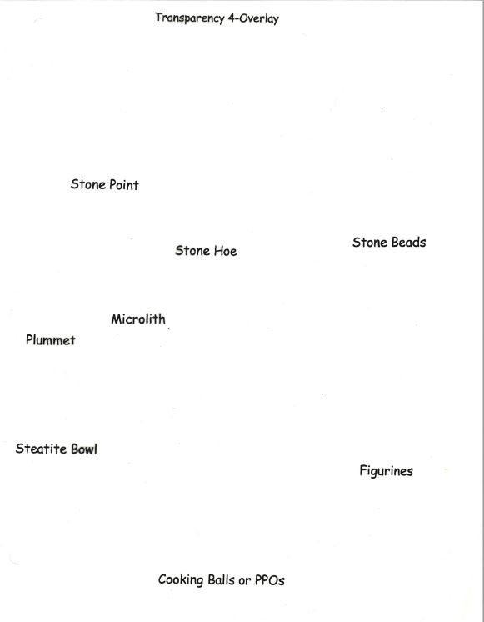
Stone Point
Stone Hoe
Stone Beads
Microlith
Plummet
Steatite Bowl
Figurines
Cooking Balls or PPOs

Slide 5
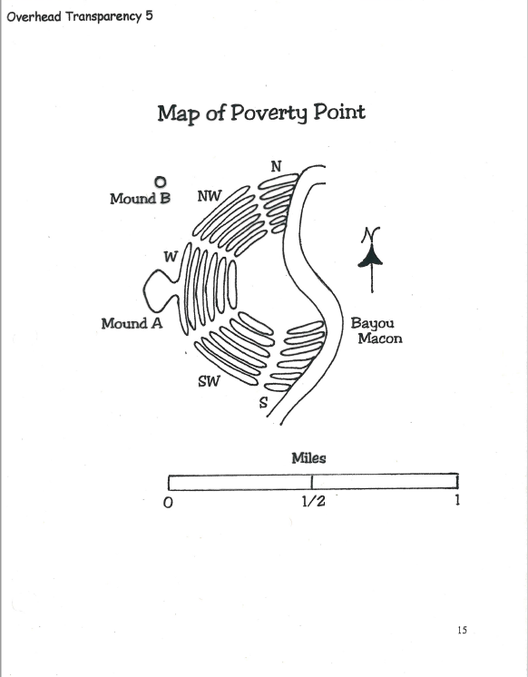

Slide 6
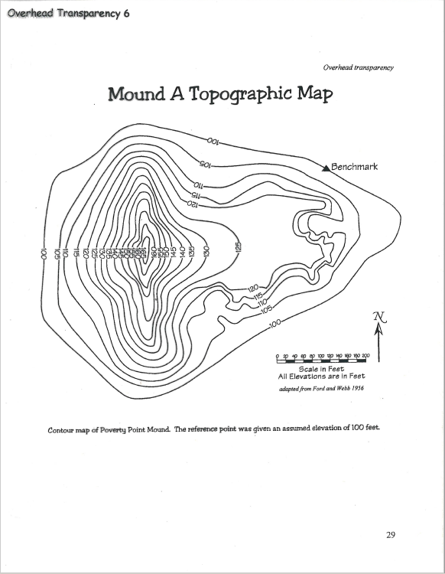

Slide 7
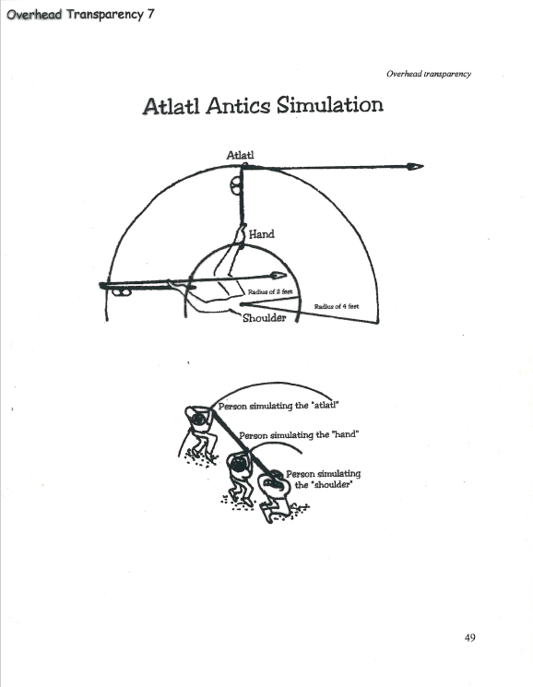

Slide 8
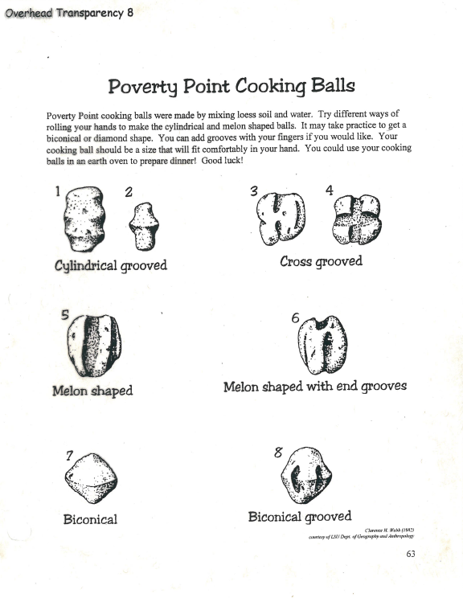

Slide 9
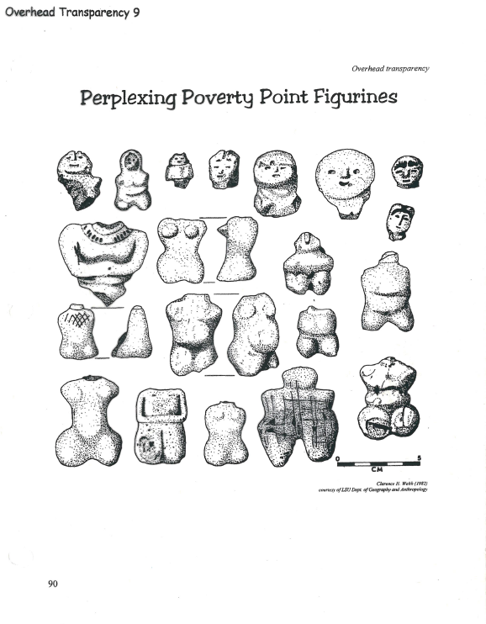

Slide 10
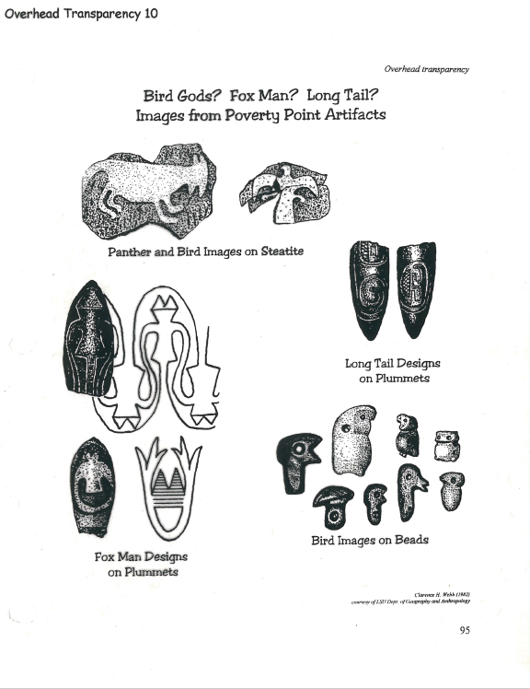

Slide 11
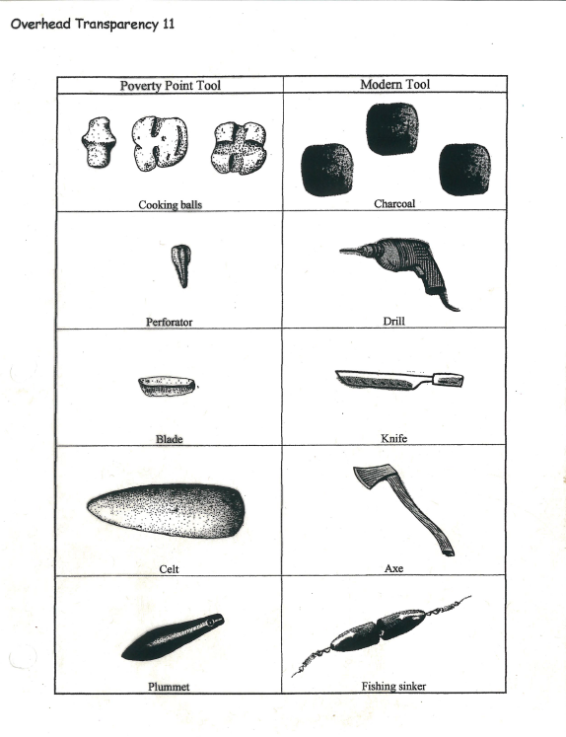

Slide 12
